Slide 1


Accelerating K-Means Clustering with Parallel Implementations and GPU Computing
Accelerating K-Means Clustering
Janki Bhimani Miriam Leeser Ningfang Mi
(bhimani@ece.neu.edu) (mel@coe.neu.edu) (ningfang@ece.neu.edu)
Electrical and Computer Engineering Dept.
Northeastern University
Boston, MA
Supported by:

Slide 2
Introduction
Accelerating K-Means Clustering

Slide 3

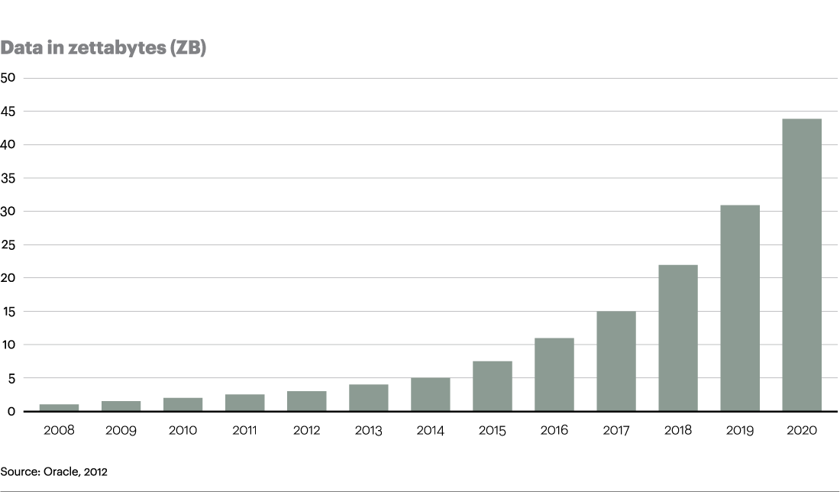

Era of Big Data
Accelerating K-Means Clustering
  Facebook loads 10-15 TB compressed data per day
  Google processes more than 20 PB data per day
Notes:
Zetta = 1 billion tera

Slide 4

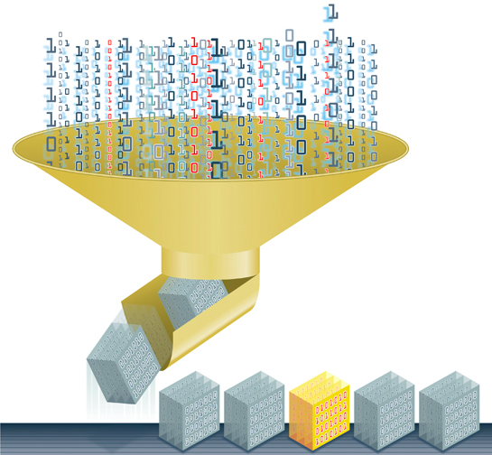
Accelerating K-Means Clustering
Handling Big Data
  Smart data processing:
    Data Classification
    Data Clustering
    Data Reduction
  Fast processing:
    Parallel computing (MPI, OpenMP)
    GPUs

Slide 5
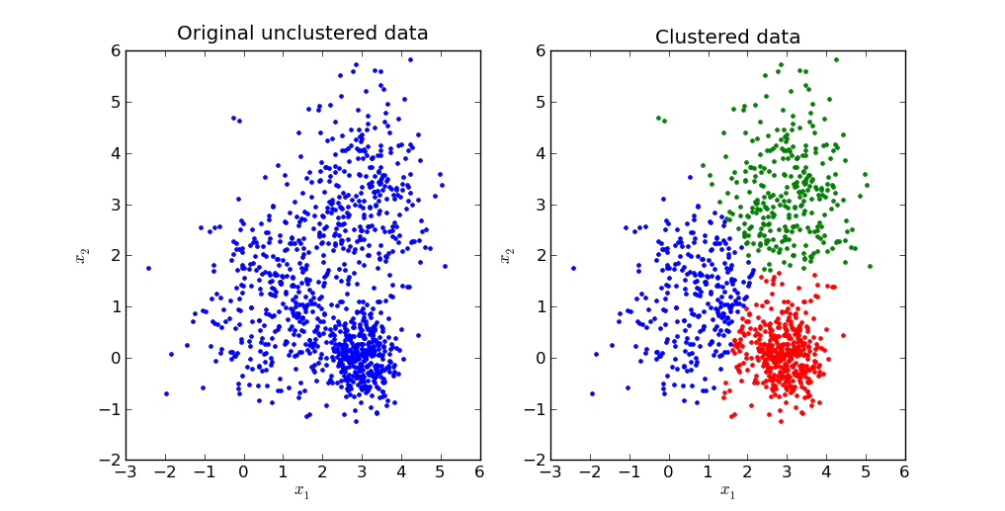
Clustering
Accelerating K-Means Clustering
Unsupervised classification of data in groups with similar features
Used to address:
  Feature extraction
  Data compression
  Dimension reduction
Methods:
  Neural networks
  Distribution based
  Iterative learning
Notes:
Go thru all

Slide 6
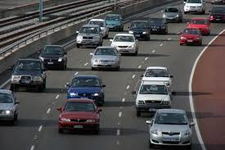



K-means Clustering
Accelerating K-Means Clustering
One of the most popular centroid-based clustering algorithm
An unsupervised, iterative machine learning algorithm
  - Partition n observations into k clusters
5

Slide 7
Contributions
Accelerating K-Means Clustering
A K-means implementation that converges based on dataset and user input.
Comparison of different styles of parallelism using different platforms for K-means implementation.
  Shared memory - OpenMP
  Distributed memory - MPI
  Graphics Processing Unit - CUDA
Speed-up the algorithm by parallel initialization

Slide 8
K-means Clustering
Accelerating K-Means Clustering

Slide 9

Which part to be parallelized?
Accelerating K-Means Clustering
90% of the total time is spent in calculating nearest centroid
(gprof)
Parallel Implementation

Slide 10
Accelerating K-Means Clustering
Parallel Feature Extraction
Most time consuming steps
Sequential
Communication
Parallel Calculation
Notes:
(K*Dimension*sizeof_double) + (K*sizeof_int) | (S/T)*sizeof_int

Slide 11
Accelerating K-Means Clustering
Other Major Challenges
  Initializing centroids
  Number of centroids (K)
  Number of iterations (I)
Three features that effect K-means clustering execution time

Slide 12
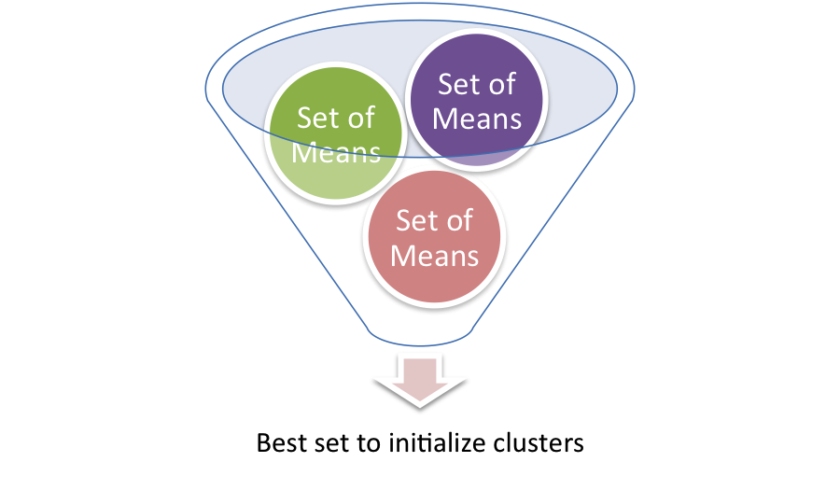
Improved Parallel Initialization
Accelerating K-Means Clustering
Goal: find a good set of initial centroids.
Our method: explore parallelism during initialization
  - Each set of means is operated on each thread independently for 5 iterations on a subset of the dataset
Best quality:
  - minimum intra-cluster distance
  - maximum inter-cluster distance
Notes:
Local minima problem:
. c .
. c .
Where c is a cluster centroid. The algorithm will stop, but a better solution is:
. .
c c
. .

Slide 13

Drop-out Technique
Accelerating K-Means Clustering
K = 12
K = 4
Goal: determine the proper number of clusters (K)
Method:
  Initially give an upper limit of K as input
  Drop some clusters which have no points assigned
Drop=out
Notes:
Animate fig

Slide 14
Convergence
Accelerating K-Means Clustering
When to stop iterating?
Tolerance: track of points changing their clusters in a given iteration compared to the prior iteration
Total # of iterations depends on the input size, contents and tolerance
  No need to be given as input
  Be decided at runtime.
Notes:
Tolerance is the permissible range of variation in a quality
We use tolerance to keep track of how many pixels may change clusters between the previous iteration and the current iteration in order to converge

Slide 15
Parallel Implementation
Accelerating K-Means Clustering

Slide 16
  Three Forms of Parallelism
Accelerating K-Means Clustering
  Shared memory (OpenMP)
  Distributed memory (MPI – Message Passing Interface)
  Graphics Processing Units (CUDA-C – Compute Unified Device Architecture)

Slide 17
Evaluation
Accelerating K-Means Clustering

Slide 18
Experiments
Accelerating K-Means Clustering
Input dataset – 2D color images
Five features – RGB channel (three), x and y position (two)
Setup
Compute nodes – Dual Intel E5 2650 CPUs with 16 physical and 32 logical cores
GPU nodes – NVIDIA Tesla K20m with 2496 CUDA cores
Vary size of image, number of clusters, tolerance and number of parallel processing tasks
Reduce Intensive
Map Intensive
Cloud 2013
Notes:
Can remove or classify by map/reduce intensive workloads

Slide 19
Accelerating K-Means Clustering
Results
Time for 300x300 pixels input image
K | Iter. | Seq. (s) | OpenMP (s) | MPI (s) | CUDA (s)
10 | 4 | 1.8 | 0.1 | 0.13 | 0.16
30 | 14 | 5.42 | 0.21 | 0.32 | 0.47
50 | 63 | 30.08 | 1.28 | 1.45 | 2.06
100 | 87 | 43 | 1.39 | 1.98 | 2.68
K_{drop_out} = 78
Tol = 0.0001
Speed Up = 30.93
Parallel versions perform better than sequential C
Multi-threaded OpenMP version outperforms rest with a speed-up of 31x for 300x300 pixels input image
  - Shared memory platform is good while working with small and medium datasets
18
Notes:
End to end execution time
Tolerance
For last set drop out no point to use K=200 for first

Slide 20
Time for 1164x1200 pixels input image
K | Iter. | Seq. (s) | OpenMP (s) | MPI (s) | CUDA (s)
30 | 21 | 1187.08 | 49.54 | 60.51 | 46.48
60 | 49 | 2651.28 | 98.77 | 115.68 | 93.68
120 | 92 | 4595.96 | 159.97 | 170.22 | 154.36
240 | 166 | 8897.72 | 300.54 | 315.15 | 294.01
K_{drop_out} = 217
Tol = 0.0001
Speed Up = 30.26
Parallel versions pexrform better than sequential C
CUDA performs best for 1164x1200 pixels input image with 30x speed-up
  - GPU is best while working with large datasets

Slide 21
Accelerating K-Means Clustering
Tolerance
Sequential computation VS Parallel computation with random sequential initialization
300x300 pixels image
K=30
16 threads
OpenMP
As the tolerance decreases, the speed-up compared to sequential C increases
20
Notes:
Speed-up number on each bar

Slide 22
Accelerating K-Means Clustering
Parallel Initialization
Parallel computation with random initialization VS parallel initialization
300x300 pixel
Tol = 0.0
16 threads
1164x1200 pixel
Tol = 0.0
16 threads
Additional 1.5x to 2.5x speed-up over parallel version
21
Notes:
title

Slide 23
Conclusions and Future work
Accelerating K-Means Clustering
22

Slide 24
Accelerating K-Means Clustering
Our K-means implementation tackles the major challenges of K-means
K-means performance evaluated across three parallel programing approaches
Our experimental results show around 35x speed-up in total
We also observe that the shared memory platform with OpenMP performs best for smaller images while a GPU with CUDA-C outperforms the rest for larger images.
Future work:
  Investigate using multiple GPUs
    hybrid approaches: OpenMP-CUDA and MPI-CUDA
  Adapt our implementation to handle larger datasets.
23
Notes:
Initializing centroids
Number of centroids (K)
Number of iterations (I)
Shared memory (OpenMP)
Distributed memory (MPI – Message Passing Interface)
Graphics Processing Units (CUDA-C – Compute Unified Device Architecture)

Slide 25


Thank You !
Accelerating K-Means Clustering
Janki Bhimani
(bhimani@ece.neu.edu)
Website: http://nucsrl.coe.neu.edu/
Supported by:

